Slide 1
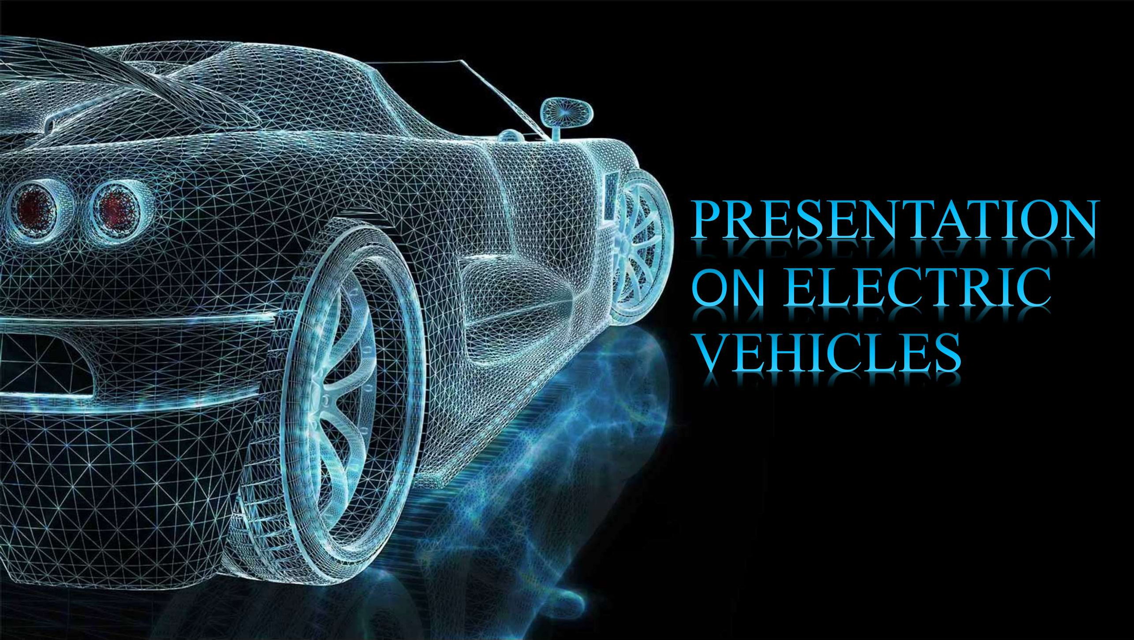
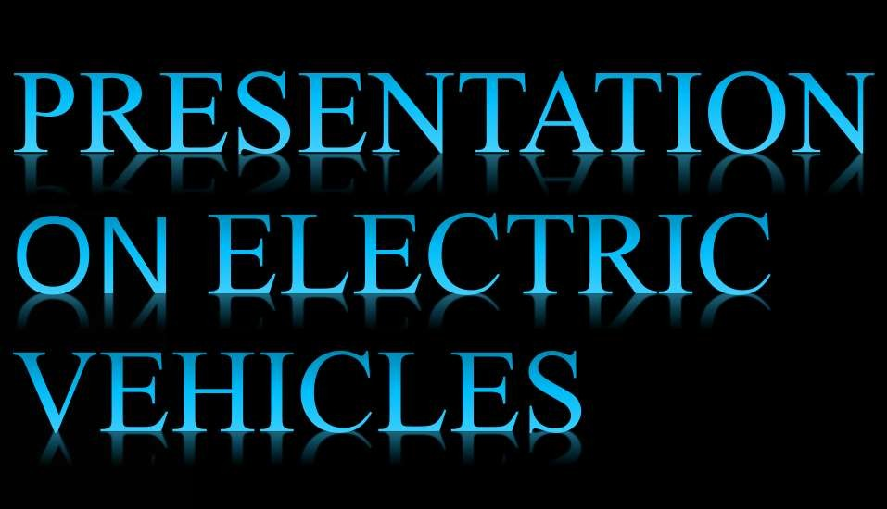

Slide 2
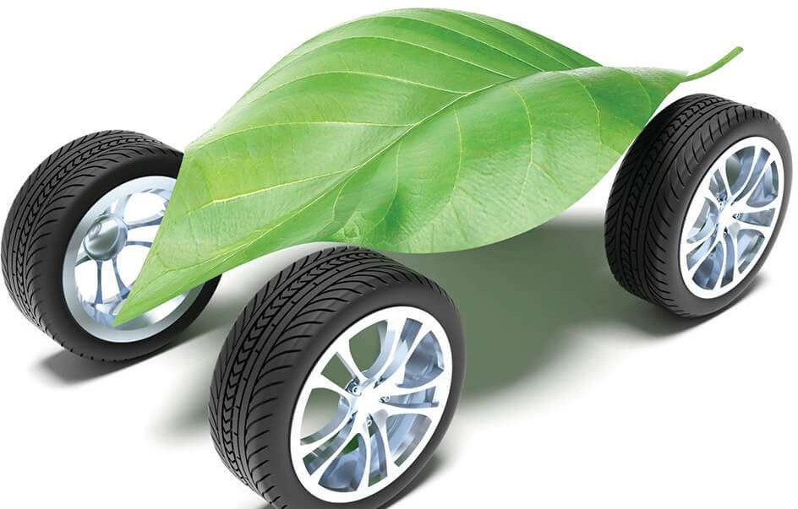
An Electric Vehicle is a vehicle that operates on an electric motor, instead of an internal combustion engine that generates power by burning a mix of fuel and gases. Electric vehicle is seen as a possible replacement for the current-generation automobile in near future to address environmental challenges.
Inspired by road going automobiles powered by electricity.
Propelled by one electric motor or more using batteries.
Electric motors give instant torque, and smooth acceleration.
Plug-in electric vehicles (EVs) are fast, fun and efficient. Maintenance is simpler and cheaper.
03

Slide 3
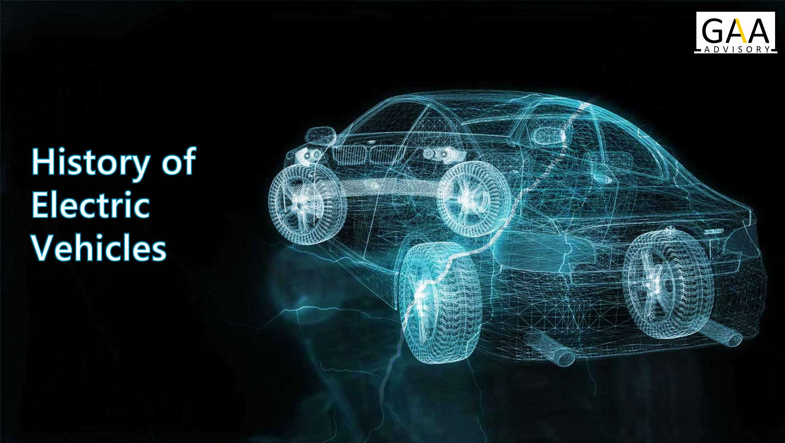

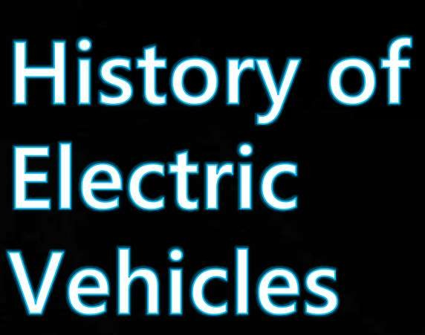
05

Slide 4
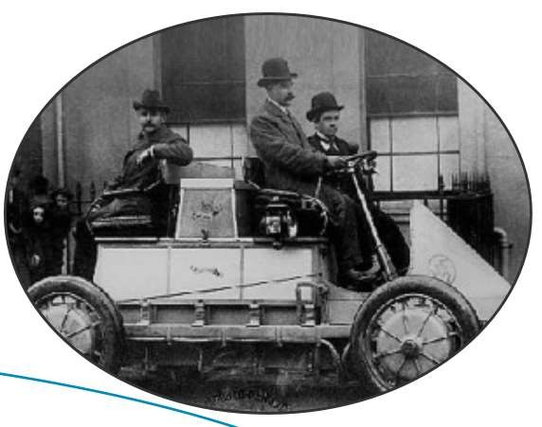
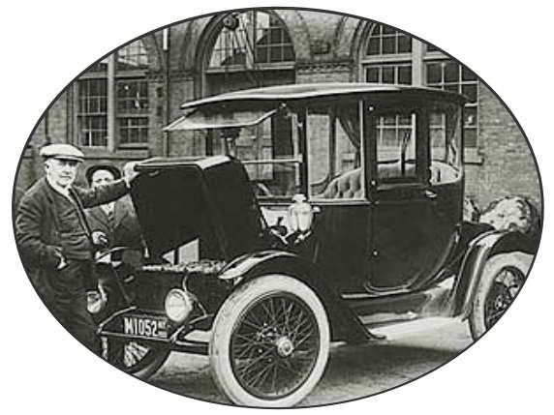

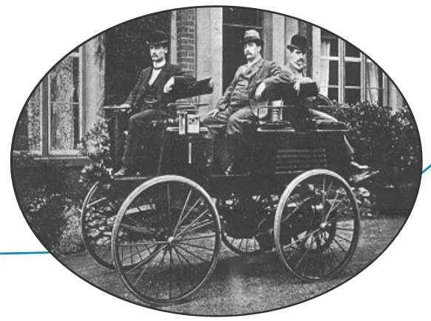

1837
Electric car begin their long history in Aberdeen, Scotland through inventor Robert Davidson. Later in 1841, he built a bigger electric train car.
1884
After more than 40 years, inventor Thomas Parker creates the first manufacturing electric automobile in London.
1890
The first electric car was produced in Lowa,
U.S.A by William Morrison. The car is little more than an electrified wagon. This six-seater has a top speed of 14 mph.
06

Slide 5
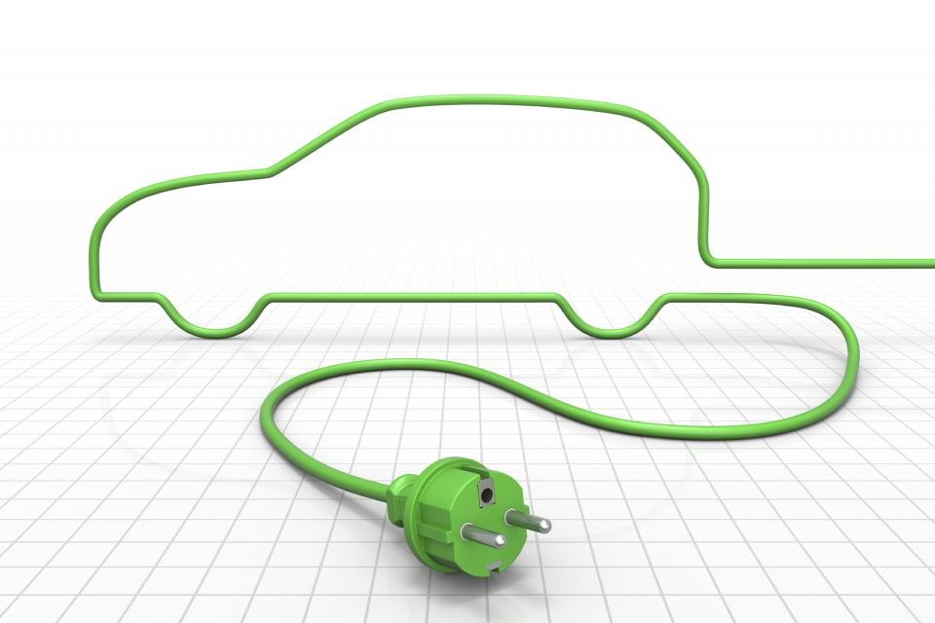


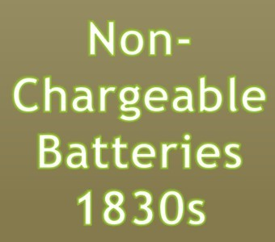
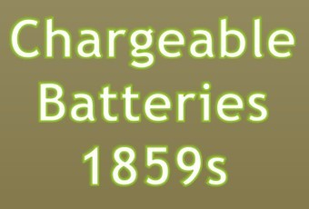



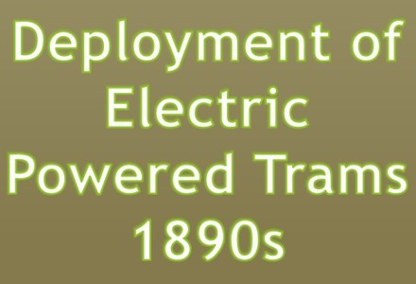
07

Slide 6
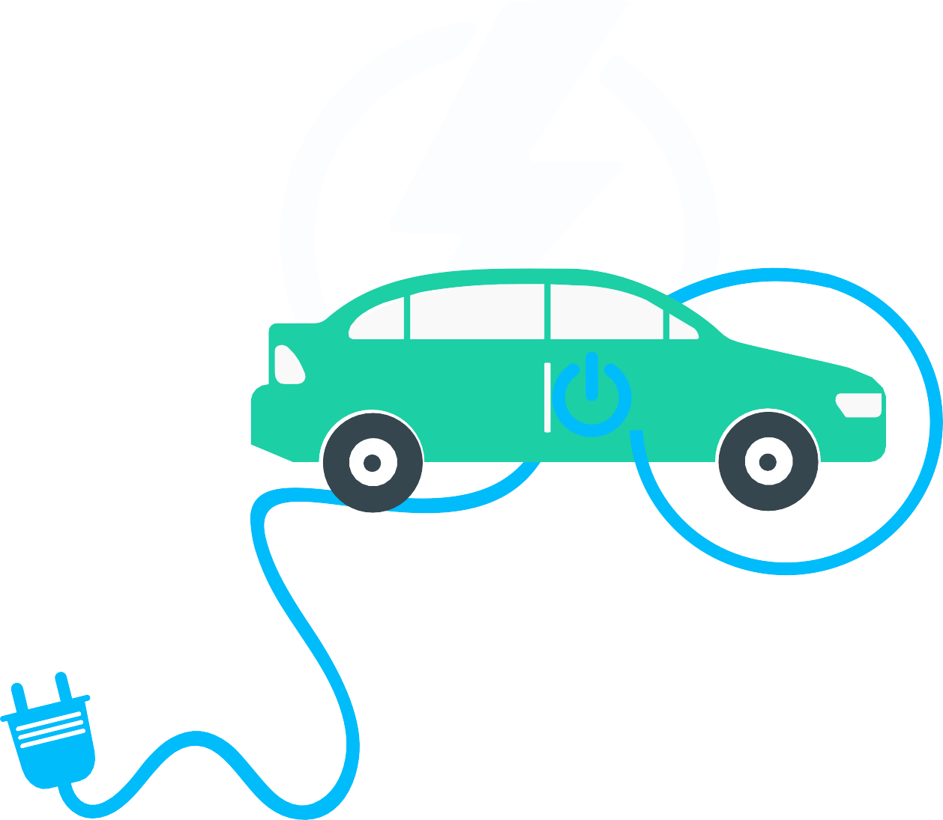
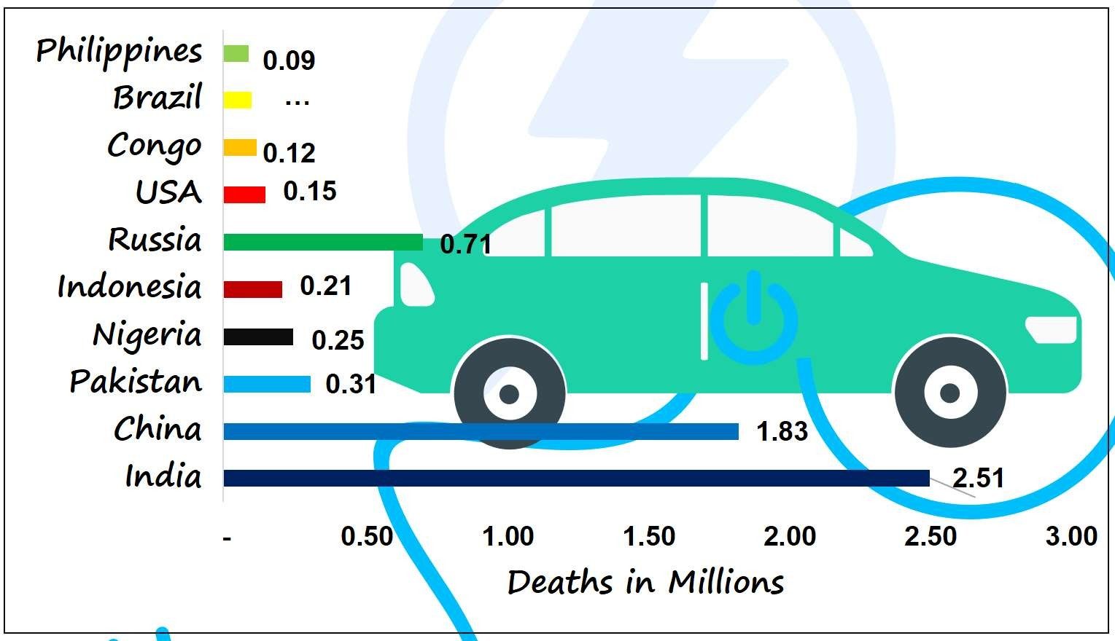


Number of deaths due to pollution is much h i g h e r i n I n d i a t h a n o t h e r developing/developed countries.
As per studies conducted, deaths due to pollution is 8 times higher in India than neighbouring country Pakistan and more than times than USA.
Due to India’s large population density, deaths occur more often than any other country.
10

Slide 7









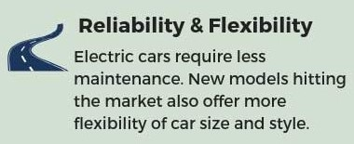
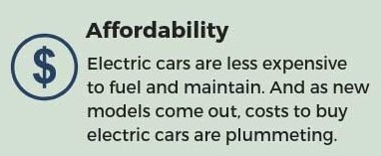
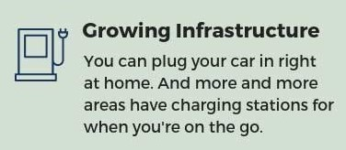

11

Slide 8
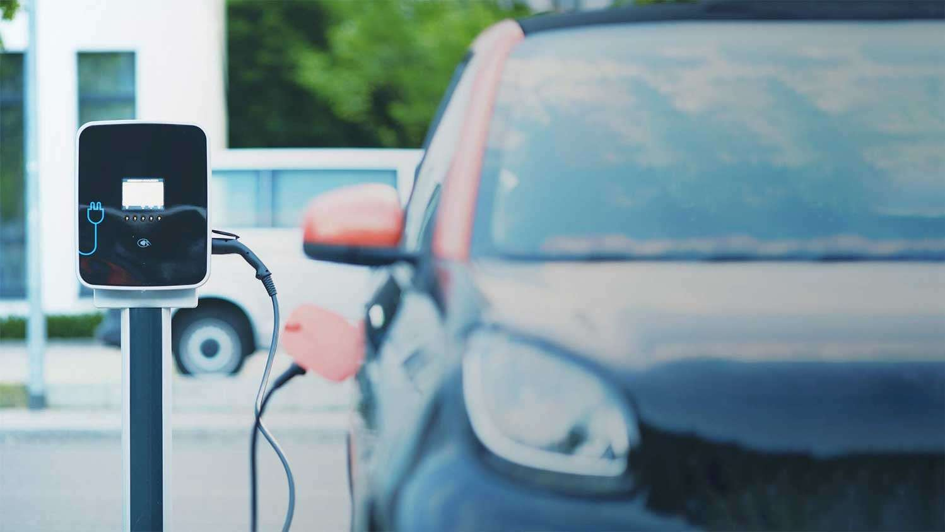
GOVERNMENT INITIATIVE AND POLICIES

Slide 9






F A M E - I I
commenced from 0 1 - A p r - 1 9 . T h e u n i o n c a b i n e t
approved an outlay of INR 100 billion.
Taxes reduced to 5% on
EVs and Electric Chargers.
2019
T h e I n d i a n g o v e r n m e n t a n n o u n c e d a strategy to reward O E M s w i t h a budget of INR 950 billion.
T h e I n d i a n government has establishe d th e National Electric Mobility Mission Plan ( NEMMP) 2020.
2015
FAME- I sc heme launched on 01 - Apr-15 till 31-Mar- 19 by the Dept. of Heavy Industries. A l l o c a t e d t o t a l financial outlay of INR 5.29 billion.
2012
The incentive p rog r a m w as s c r a p p e d , resulting in a 70% reduction i n e l e c t r i c vehicle sales.
2010
2013

Slide 10

Electric Vehicle Market In India

Slide 11


The India Electric Vehicle Market was valued at USD 5 billion in 2020, and is predicted to grow to USD 47 billion by 2026, with a CAGR of more than 44% during the forecast period (2021 - 2026).
“ The government target for the deployment of DC fast charges at various corridors and highway is expected to boost the market of this category during the forecast period ”
2019
Market Size
$1,027.9
thousand
2025
Market Size
$13,833
thousand
Market Growth Rate (2019-25)
54.2%
In India, the electric vehicle (EV) market is still in its infancy. Due to several government initiatives and policies, it is predicted to expand at a considerably quicker rate throughout the projection period.
To lower their carbon footprint, e-commerce businesses (such as Amazon) are starting efforts to deploy e-Mobility for last-mile delivery. India is experimenting with e-Mobility for public transportation and has already deployed electric intercity buses in many major cities.
Furthermore, state governments are actively involved in the implementation of legislation that encourage the use of electric vehicles.

Slide 12
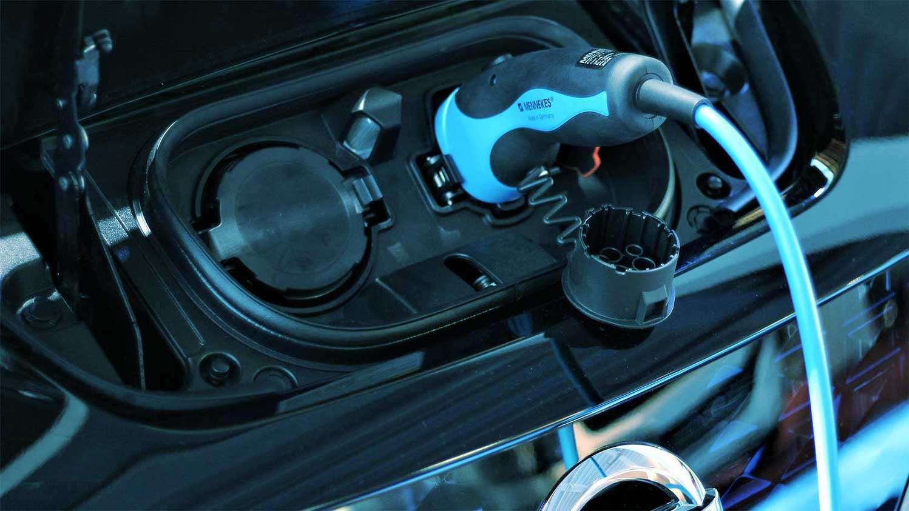
Key Players of the
EV Market
24

Slide 13







25

Slide 14







1,38,910.20
Crore Units
Power generated in India in 2019-20
1,39,766.90
Crore Units
Power demand
16,000
Crore Units
Increase in power demands
30%
Vehicles on road to be electric by 2030
856.70
Crore Units
Shortfall
India’s challenges are quite different compared to international markets. The electricity supply is not consistent across the country and keeps fluctuating in many regions.
28

Slide 15

Although the EV industry expected the budget to be as groundbreaking as promised, it didn’t quite deliver on all fronts. This has resulted in a mix of reactions in the industry. The government has announced an increase in customs duties on some vehicle parts, which might affect the e-mobility industry. The government, on the other hand, has suggested launching a voluntary automobile scrappage program this year in the hopes of encouraging people to buy more ecologically friendly automobiles. Its goal is to phase out any business vehicle that is more than 15-20 years old by 2025.
As per the GAA opinion, the government should focus more on lowering of GST and import duty, creating financial solutions & awareness for EVs and reforms in FAME II. Policies and incentives from the government will be recognized as major drivers in the growth of the EV market. The low cost of EVs coupled with full automation can bring the EV market to a new level. This can be achieved with the help of wireless charging or by reducing the size of batteries and hence the cost of the vehicles, making it more affordable for the masses But as of now, the prices of electric vehicle are too high with a lesser range, people do not see it as a viable option. However, it is not all doom and gloom for electric vehicles. The industry continues to grow at a rapid pace. In the long run, consumer demand triumphs, as evidenced by recent industry developments. All in all, given the growing awareness, cost-effective solutions, and convenience that the EV industry is gaining, it’s safe to say that the future of EVs in India is positively electric.
31

